Slide 1

C How to Program
Eighth Edition
Chapter 17
Classes: A Deeper Look; Throwing Exceptions
Copyright © 2016, 2013, 2010 Pearson Education, Inc. All Rights Reserved
Notes:
If this PowerPoint presentation contains mathematical equations, you may need to check that your computer has the following installed:
1) MathType Plugin
2) Math Player (free versions available)
3) NVDA Reader (free versions available)

Slide 2
Learning Objectives
Use an include guard.
Access class members via an object’s name, a reference or a pointer.
Use destructors to perform “termination housekeeping.”
Learn the order of constructor and destructor calls.
Learn about the dangers of returning a reference to private data.
Assign the data members of one object to those of another object.
Create objects composed of other objects.
Use friend functions and friend classes.
Use the this pointer in a member function to access a non-static class member.
Use static data members and member functions.

Slide 3
Outline (1 of 2)
17.1 Introduction
17.2 Time Class Case Study
17.3 Class Scope and Accessing Class Members
17.4 Access Functions and Utility Functions
17.5 Time Class Case Study: Constructors with Default arguments
17.6 Destructors
17.7 When Constructors and Destructors Are Called
17.8 Time Class Case Study: A Subtle Trap— Returning a Reference or a Pointer to a private Data Member

Slide 4
Outline (2 of 2)
17.9 Default Memberwise Assignment
17.10 const Objects and const Member Functions
17.11 Composition: Objects as Members of Classes
17.12 friend Functions and friend Classes
17.13 Using the this Pointer
17.14 static Class Members
17.15 Wrap-Up

Slide 5
17.1 Introduction (1 of 3)
This chapter takes a deeper look at classes.
Coverage includes:
The example also demonstrates using an include guard in headers to prevent header code from being included in the same source code file more than once.
We demonstrate how client code can access a class’s public members via the name of an object, a reference to an object or a pointer to an object.
We discuss access functions that can read or write an object’s data members.
We also demonstrate utility functions—private member functions that support the operation of the class’s public member functions.

Slide 6
17.1 Introduction (2 of 3)
How default arguments can be used in constructors.
Destructors that perform “termination housekeeping” on objects before they’re destroyed.
The order in which constructors and destructors are called.
We show that returning a reference or pointer to private data breaks the encapsulation of a class, allowing client code to directly access an object’s data.
We use default memberwise assignment to assign an object of a class to another object of the same class.

Slide 7
17.1 Introduction (3 of 3)
const objects and const member functions to prevent modifications of objects and enforce the principle of least privilege.
Composition—a form of reuse in which a class can have objects of other classes as members.
Friendship to specify that a nonmember function can also access a class’s non-public members—a technique that’s often used in operator overloading for performance reasons.
this pointer, which is an implicit argument in all calls to a class’s non-static member functions, allowing them to access the correct object’s data members and non-static member functions.

Slide 8
17.2 Time Class Case Study (1 of 8)
Our first example (Figure 17.1 (see slide 11)) creates class Time and tests the class.

Slide 9
Good Programming Practice 17.1
For clarity and readability, use each access specifier only once in a class definition. Place public members first, where they’re easy to locate.

Slide 10
Software Engineering Observation 17.1
Each member of a class should have private visibility unless it can be proven that the element needs public visibility. This is another example of the principle of least privilege.

Slide 11
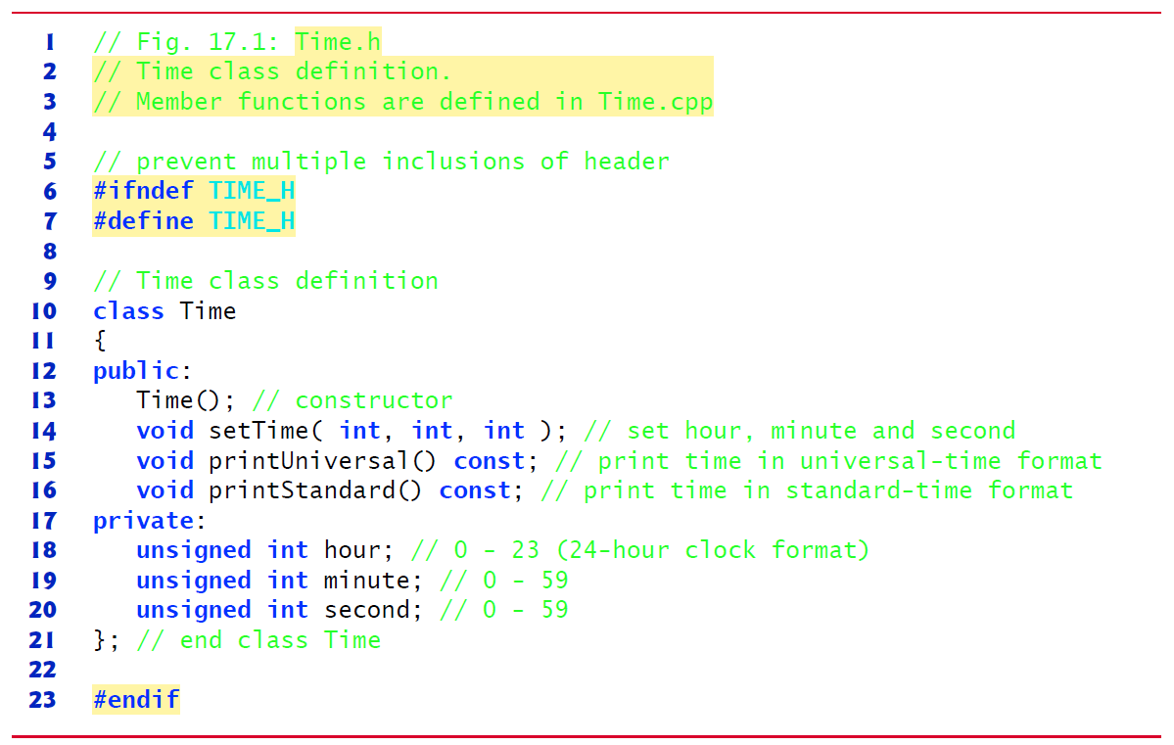
Figure 17.1 Time Class Definition

Slide 12

17.2 Time Class Case Study (2 of 8)
In Figure 17.1, the class definition is enclosed in the following include guard:
Prevents the code between #ifndef and #endif from being included if the name TIME_H has been defined.
If the header has not been included previously in a file, the name TIME_H is defined by the #define directive and the header file statements are included.
If the header has been included previously, TIME_H is defined already and the header file is not included again

Slide 13
Error-Prevention Tip 17.1
Use #ifndef, #define and #endif preprocessing directives to form an include guard that prevents headers from being included more than once in a source-code file.

Slide 14
Good Programming Practice 17.2
By convention, use the name of the header in uppercase with the period replaced by an underscore in the #ifndef and #define preprocessing directives of a header.

Slide 15
17.2 Time Class Case Study (3 of 8)
Time Class Member Functions
In Figure 17.2, the Time constructor (lines 11–14) initializes the data members to 0—the universal-time equivalent of 12 A M.
Invalid values cannot be stored in the data members of a Time object, because the constructor is called when the Time object is created, and all subsequent attempts by a client to modify the data members are scrutinized by function setTime (discussed shortly).
You can define overloaded constructors for a class.

Slide 16
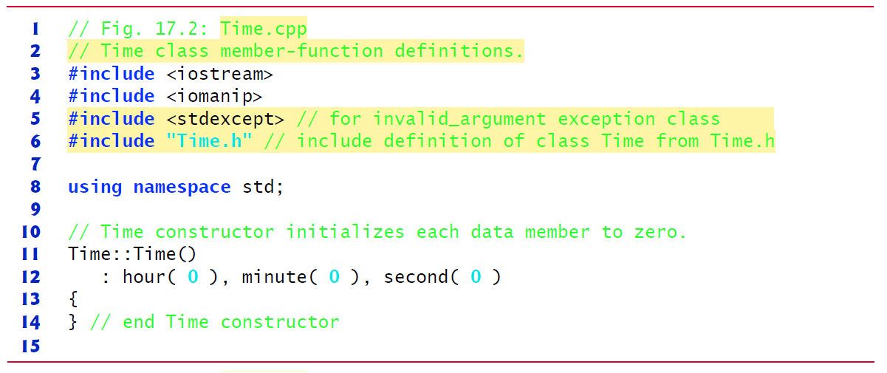
Figure 17.2 Time Class Member-Function Definitions (1 of 3)

Slide 17
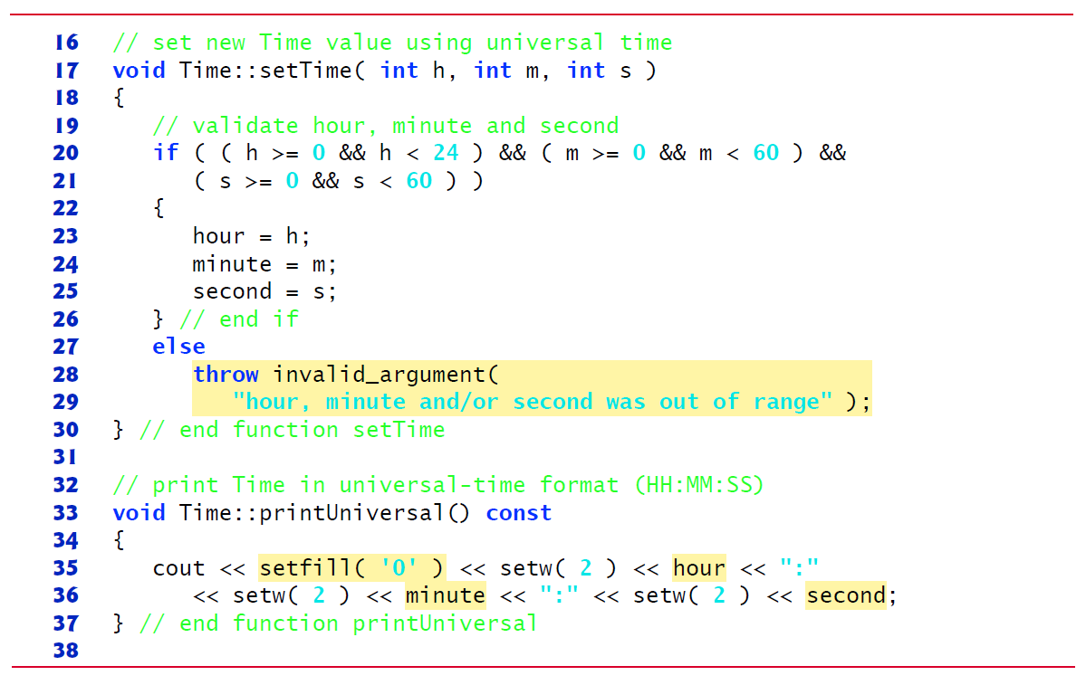
Figure 17.2 Time Class Member-Function Definitions (2 of 3)

Slide 18
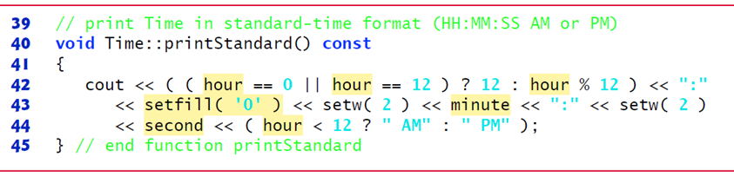
Figure 17.2 Time Class Member-Function Definitions (3 of 3)

Slide 19
17.2 Time Class Case Study (4 of 8)
Before C++11, only static const int data members (which you saw in Chapter 7) could be initialized where they were declared in the class body.
For this reason, data members typically should be initialized by the class’s constructor as there is no default initialization for fundamental-type data members.
As of C++11, you can now use an in-class initializer to initialize any data member where it’s declared in the class definition.

Slide 20
17.2 Time Class Case Study (5 of 8)
Parameterized stream manipulator setfill specifies the fill character that is displayed when an integer is output in a field wider than the number of digits in the value.
The fill characters appear to the left of the digits in the number, because the number is right aligned by default—for left aligned values, the fill characters would appear to the right.
If the number being output fills the specified field, the fill character will not be displayed.
Once the fill character is specified with setfill, it applies for all subsequent values that are displayed in fields wider than the value being displayed.

Slide 21
Error-Prevention Tip 17.2
Each sticky setting (such as a fill character or floating-point precision) should be restored to its previous setting when it’s no longer needed. Failure to do so may result in incorrectly formatted output later in a program. Chapter 21, Stream Input/Output: A Deeper Look, discusses how to reset the fill character and precision.

Slide 22
17.2 Time Class Case Study (6 of 8)
Defining Member Functions Outside the Class Definition; Class Scope
Even though a member function declared in a class definition may be defined outside that class definition, that member function is still within that class’s scope.
If a member function is defined in the class’s body, the compiler attempts to inline calls to the member function.

Slide 23
Performance Tip 17.1
Defining a member function inside the class definition inlines the member function (if the compiler chooses to do so). This can improve performance.

Slide 24
Software Engineering Observation 17.2
Only the simplest and most stable member functions (i.e., whose implementations are unlikely to change) should be defined in the class header.

Slide 25
Software Engineering Observation 17.3
Using an object-oriented programming approach often simplifies function calls by reducing the number of parameters. This benefit derives from the fact that encapsulating data members and member functions within a class gives the member functions the right to access the data members.

Slide 26
Software Engineering Observation 17.4
Member functions are usually shorter than functions in non-object-oriented programs, because the data stored in data members have ideally been validated by a constructor or by member functions that store new data. Because the data is already in the object, the member-function calls often have no arguments or fewer arguments than function calls in non-object-oriented languages. Thus, the calls, the function definitions and the function prototypes are shorter. This improves many aspects of program development.

Slide 27
Error-Prevention Tip 17.3
The fact that member function calls generally take either no arguments or substantially fewer arguments than conventional function calls in non-object-oriented languages reduces the likelihood of passing the wrong arguments, the wrong types of arguments or the wrong number of arguments.

Slide 28
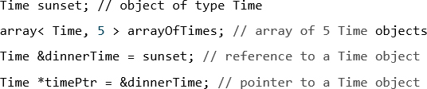
17.2 Time Class Case Study (7 of 8)
Using Class Time
Once class Time has been defined, it can be used as a type in object, array, pointer and reference declarations as follows:
Figure 17.3 uses class Time.

Slide 29
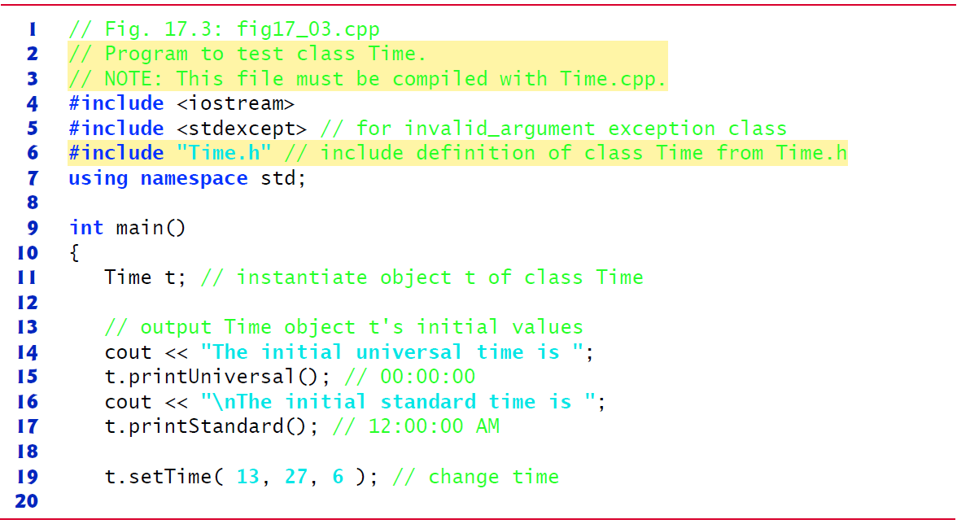
Figure 17.3 Program to Test Class Time (1 of 3)

Slide 30
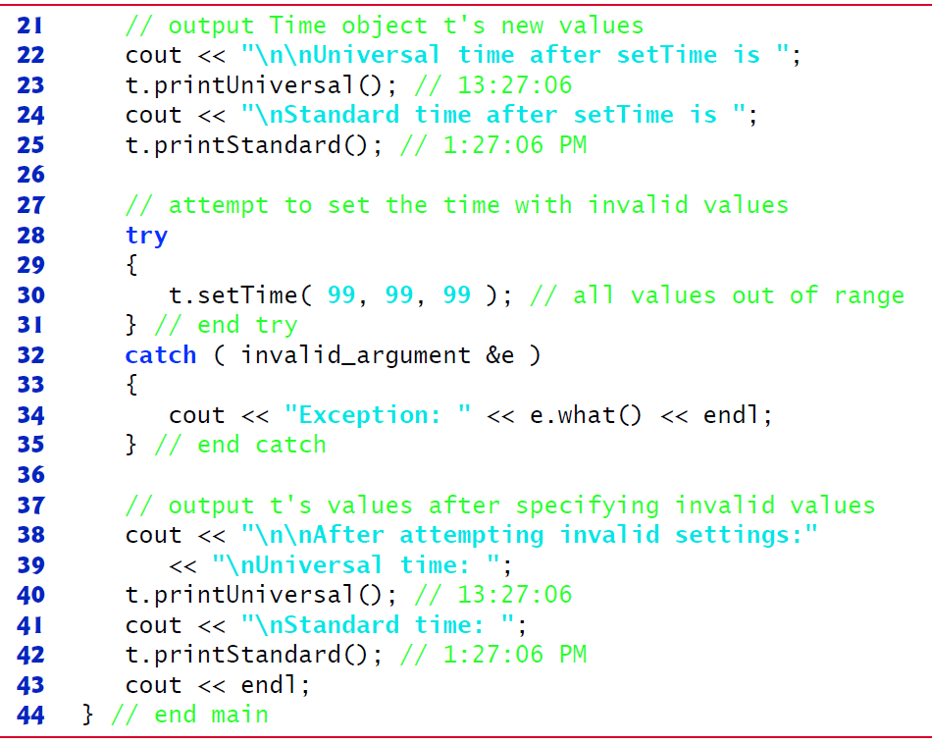
Figure 17.3 Program to Test Class Time (2 of 3)

Slide 31
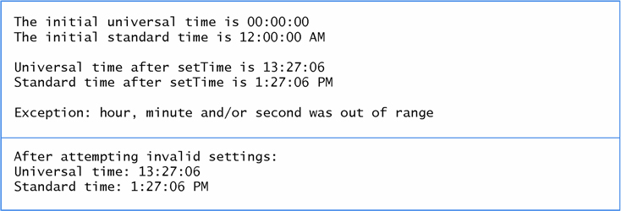
Figure 17.3 Program to Test Class Time (3 of 3)

Slide 32
17.2 Time Class Case Study (8 of 8)
Object Size
People new to object-oriented programming often suppose that objects must be quite large because they contain data members and member functions.
Logically, this is true—you may think of objects as containing data and functions (and our discussion has certainly encouraged this view); physically, however, this is not true.

Slide 33
Performance Tip 17.2
Objects contain only data, so objects are much smaller than if they also contained member functions. The compiler creates one copy (only) of the member functions separate from all objects of the class. All objects of the class share this one copy. Each object, of course, needs its own copy of the class’s data, because the data can vary among the objects. The function code is nonmodifiable and, hence, can be shared among all objects of one class.

Slide 34
17.3 Class Scope and Accessing Class Members (1 of 5)
A class’s data members and member functions belong to that class’s scope.
Nonmember functions are defined at global namespace scope, by default.
Within a class’s scope, class members are immediately accessible by all of that class’s member functions and can be referenced by name.
Outside a class’s scope, public class members are referenced through one of the handles on an object—an object name, a reference to an object or a pointer to an object.

Slide 35
17.3 Class Scope and Accessing Class Members (2 of 5)
Class Scope and Block Scope
If a member function defines a variable with the same name as a variable with class scope, the class-scope variable is hidden in the function by the block-scope variable.
Such a hidden variable can be accessed by preceding the variable name with the class name followed by the scope resolution operator (::).

Slide 36
17.3 Class Scope and Accessing Class Members (3 of 5)
Dot (.) and Arrow
Member Selection Operators
The dot member selection operator (.) is preceded by an object’s name or with a reference to an object to access the object’s members.
The arrow member selection operator
is preceded by a pointer to an object to access the object’s members.

Slide 37
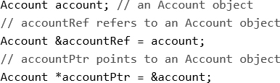
17.3 Class Scope and Accessing Class Members (4 of 5)
Accessing public Class Members Through Objects, References and Pointers
Consider an Account class that has a public setBalance member function. Given the following declarations:

Slide 38
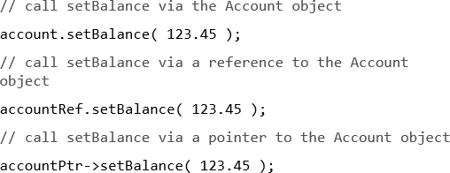
17.3 Class Scope and Accessing Class Members (5 of 5)
You can invoke member function setBalance using the dot (.)
and arrow
member selection operators as follows:

Slide 39
17.4 Access Functions and Utility Functions
Access Functions
Access functions can read or display data.
A common use for access functions is to test the truth or falsity of conditions—such functions are often called predicate functions.
Utility Functions
A utility function (also called a helper function) is a private member function that supports the operation of the class’s other member functions.

Slide 40
17.5 Time Class Case Study: Constructors with Default Arguments (1 of 6)
The program of Figures 17.4 (see slides 41-42)–17.6 (see slides 48-50) enhances class Time to demonstrate how arguments are implicitly passed to a constructor.
The constructor defined in Figure 17.2 (see slide 16-17) initialized hour, minute and second to 0 (i.e., midnight in universal time).
Like other functions, constructors can specify default arguments.

Slide 41
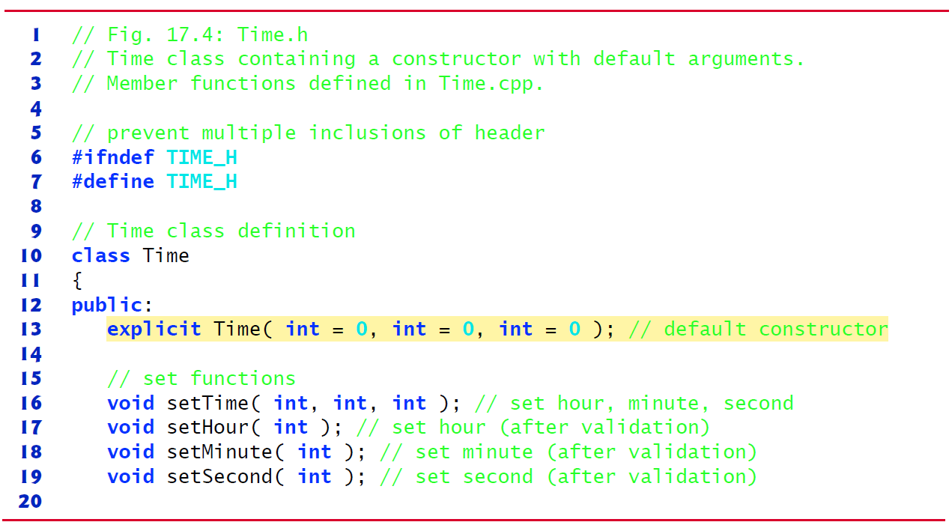
Figure 17.4 Time Class Containing a Constructor with Default Arguments (1 of 2)

Slide 42
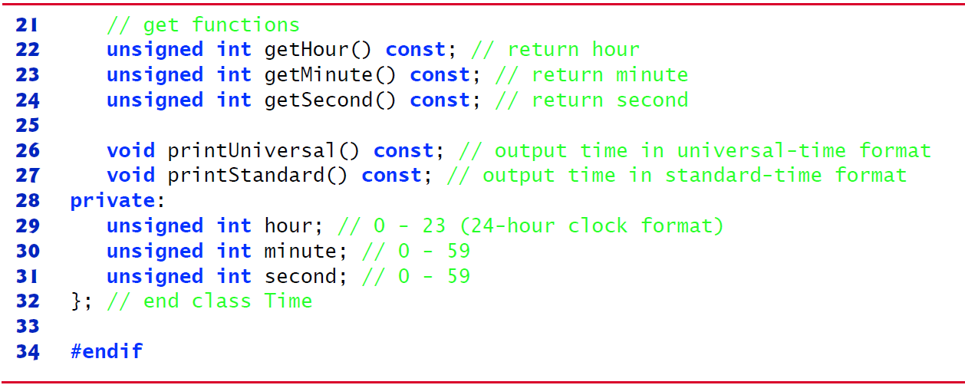
Figure 17.4 Time Class Containing a Constructor with Default Arguments (2 of 2)

Slide 43
Software Engineering Observation 17.5
Any change to the default argument values of a function requires the client code to be recompiled (to ensure that the program still functions correctly).

Slide 44
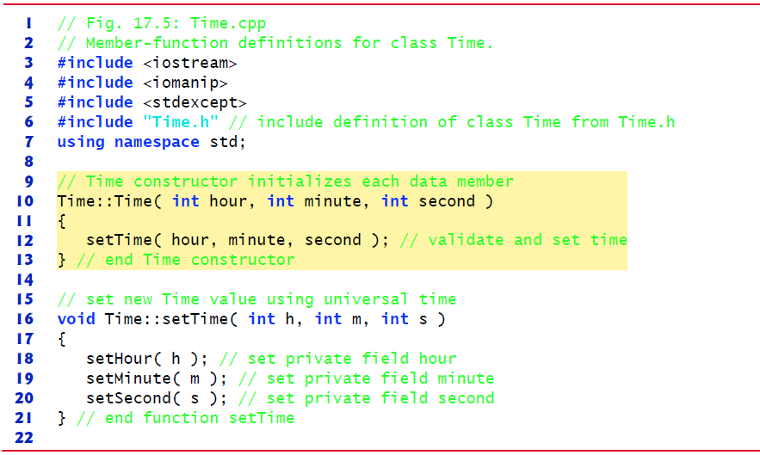
Figure 17.5 Member-Function Definitions for Class Time (1 of 4)

Slide 45
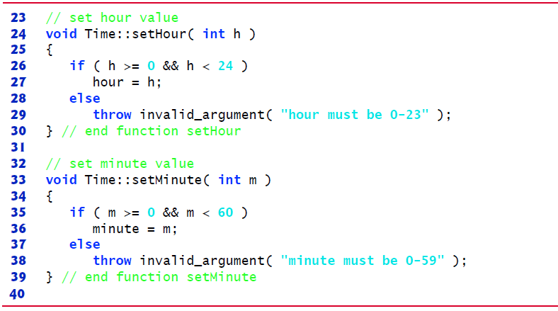
Figure 17.5 Member-Function Definitions for Class Time (2 of 4)

Slide 46
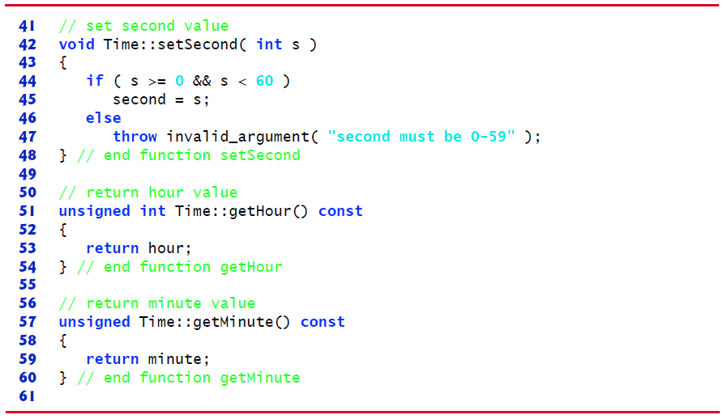
Figure 17.5 Member-Function Definitions for Class Time (3 of 4)

Slide 47
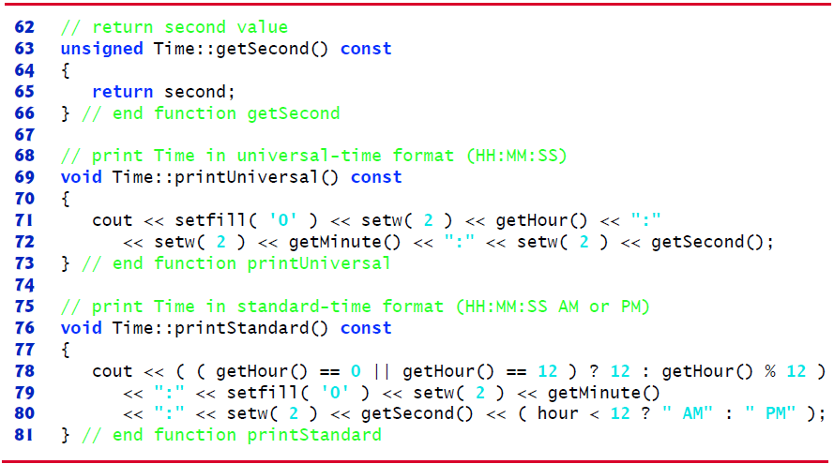
Figure 17.5 Member-Function Definitions for Class Time (4 of 4)

Slide 48
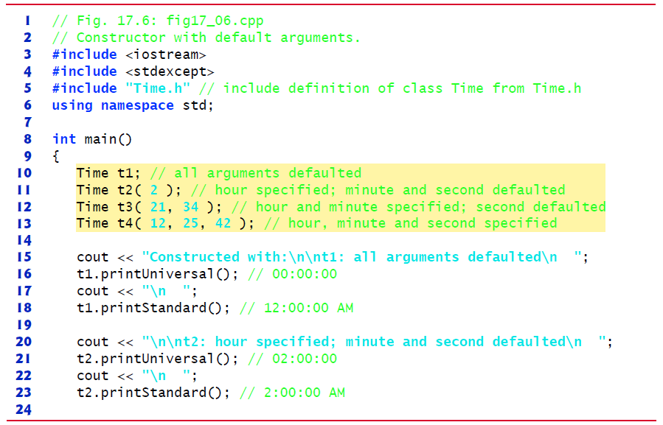
Figure 17.6 Constructor with Default Arguments (1 of 3)

Slide 49
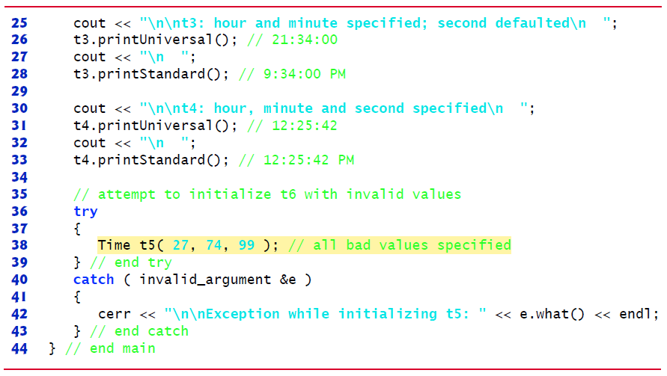
Figure 17.6 Constructor with Default Arguments (2 of 3)

Slide 50
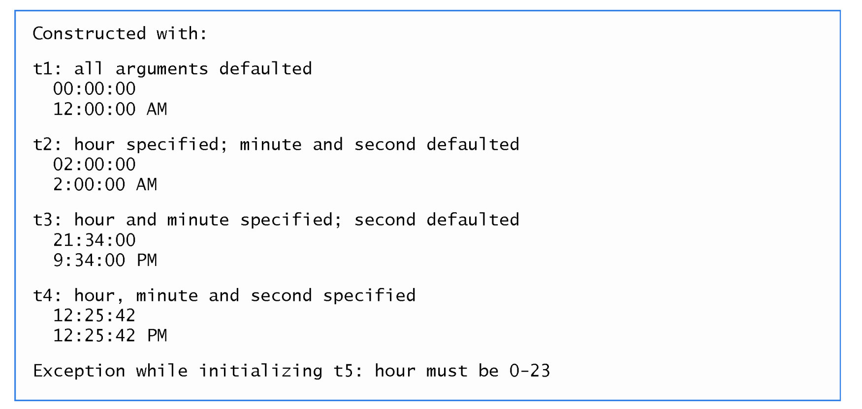
Figure 17.6 Constructor with Default Arguments (3 of 3)

Slide 51
17.5 Time Class Case Study: Constructors with Default Arguments (2 of 6)
Notes Regarding Class Time’s Set and Get Functions and Constructor
Time’s set and get functions are called throughout the class’s body.
In each case, these functions could have accessed the class’s private data directly.
Consider changing the representation of the time from three int values (requiring 12 bytes of memory on systems with four-byte ints) to a single int value representing the total number of seconds that have elapsed since midnight (requiring only four bytes of memory).
If we made such a change, only the bodies of the functions that access the private data directly would need to change.
No need to modify the bodies of the other functions.

Slide 52
17.5 Time Class Case Study: Constructors with Default Arguments (3 of 6)
Designing the class in this manner reduces the likelihood of programming errors when altering the class’s implementation.
Duplicating statements in multiple functions or constructors makes changing the class’s internal data representation more difficult.

Slide 53
Software Engineering Observation 17.6
If a member function of a class already provides all or part of the functionality required by a constructor (or other member function) of the class, call that member function from the constructor (or other member function). This simplifies the maintenance of the code and reduces the likelihood of an error if the implementation of the code is modified. As a general rule: Avoid repeating code.

Slide 54
Common Programming Error 17.1
A constructor can call other member functions of the class, such as set or get functions, but because the constructor is initializing the object, the data members may not yet be initialized. Using data members before they have been properly initialized can cause logic errors.

Slide 55


17.5 Time Class Case Study: Constructors with Default Arguments (4 of 6)
C++11: Using List Initializers to Call Constructors
C++11 now provides a uniform initialization syntax called list initializers that can be used to initialize any variable. Lines 11–13 of Figure 17.6 (see slides 48-50) can be written using list initializers as follows:
or
The form without the = is preferred.

Slide 56
17.5 Time Class Case Study: Constructors with Default Arguments (5 of 6)
C++11: Overloaded Constructors and Delegating Constructors
A class’s constructors and member functions can also be overloaded.
Overloaded constructors typically allow objects to be initialized with different types and/or numbers of arguments.
To overload a constructor, provide in the class definition a prototype for each version of the constructor, and provide a separate constructor definition for each overloaded version.
This also applies to the class’s member functions.

Slide 57

17.6 Time Class Case Study: Constructors with Default Arguments
In Figures. 17.4 (see slides 41-42)–17.6 (see slides 48-50), the Time constructor with three parameters had a default argument for each parameter. We could have defined that constructor instead as four overloaded constructors with the following prototypes:
C++11 now allows constructors to call other constructors in the same class.
The calling constructor is known as a delegating constructor—it delegates its work to another constructor.

Slide 58
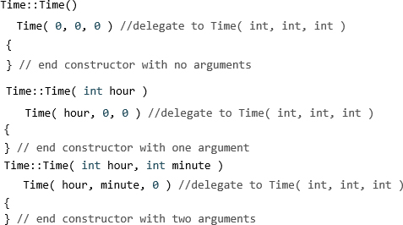
17.5 Time Class Case Study: Constructors with Default Arguments (6 of 6)
The first three of the four Time constructors declared on the previous slide can delegate work to one with three int arguments, passing 0 as the default value for the extra parameters.
Use a member initializer with the name of the class as follows:

Slide 59
17.6 Destructors
The name of the destructor for a class is the tilde character
followed by the class name.
Called implicitly when an object is destroyed.
The destructor itself does not actually release the object’s memory—it performs termination housekeeping before the object’s memory is reclaimed, so the memory may be reused to hold new objects.
Receives no parameters and returns no value.
May not specify a return type—not even void.
A class has one destructor.
A destructor must be public.
If you do not explicitly define a destructor, the compiler defines an “empty” destructor.

Slide 60
17.7 When Constructors and Destructors Are Called (1 of 5)
Constructors and destructors are called implicitly.
The order in which these function calls occur depends on the order in which execution enters and leaves the scopes where the objects are instantiated.
Generally, destructor calls are made in the reverse order of the corresponding constructor calls
The storage classes of objects can alter the order in which destructors are called.

Slide 61
17.7 When Constructors and Destructors Are Called (2 of 5)
Constructors and Destructors for Objects in Global Scope
Constructors are called for objects defined in global scope (also called global namespace scope) before any other function (including main) in that program begins execution (although the order of execution of global object constructors between files is not guaranteed).
The corresponding destructors are called when main terminates.
Function exit forces a program to terminate immediately and does not execute the destructors of local objects.
Function abort performs similarly to function exit but forces the program to terminate immediately, without allowing the destructors of any objects to be called.

Slide 62
17.7 When Constructors and Destructors Are Called (3 of 5)
Constructors and Destructors for Local Objects
Constructors and destructors for local objects are called each time execution enters and leaves the scope of the object.
Destructors are not called for local objects if the program terminates with a call to function exit or function abort.

Slide 63
17.7 When Constructors and Destructors Are Called (4 of 5)
Constructors and Destructors for static Local Objects
The constructor for a static local object is called only once, when execution first reaches the point where the object is defined—the corresponding destructor is called when main terminates or the program calls function exit.
Global and static objects are destroyed in the reverse order of their creation.
Destructors are not called for static objects if the program terminates with a call to function abort.

Slide 64
17.7 When Constructors and Destructors Are Called (5 of 5)
Demonstrating When Constructors and Destructors Are Called
The program of Figures 17.7 (see slide 65)–17.9 (see slides 67-69) demonstrates the order in which constructors and destructors are called for objects of class CreateAndDestroy (Figure 17.7 and Figure 17.8 (see slides 66)) of various storage classes in several scopes.

Slide 65
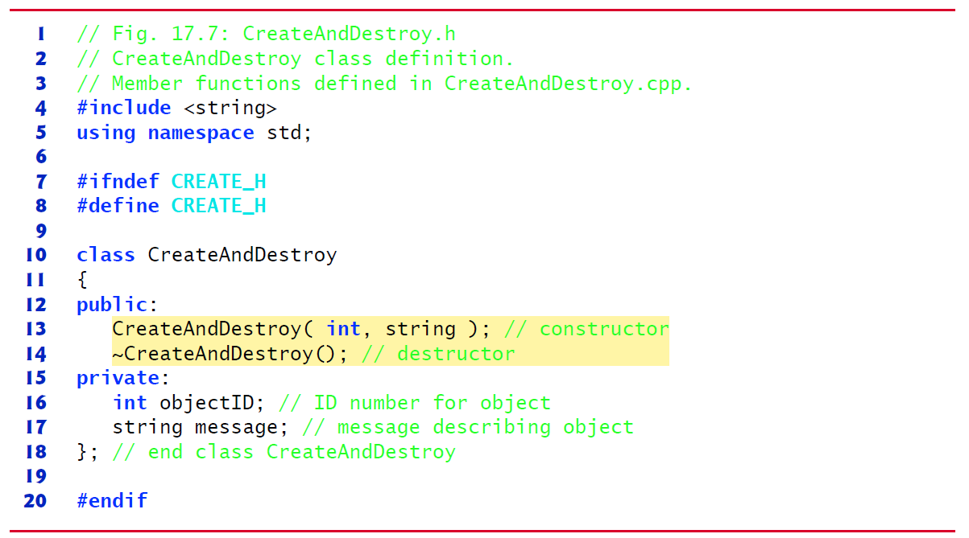
Figure 17.7 CreateAndDestroy Class Definition

Slide 66
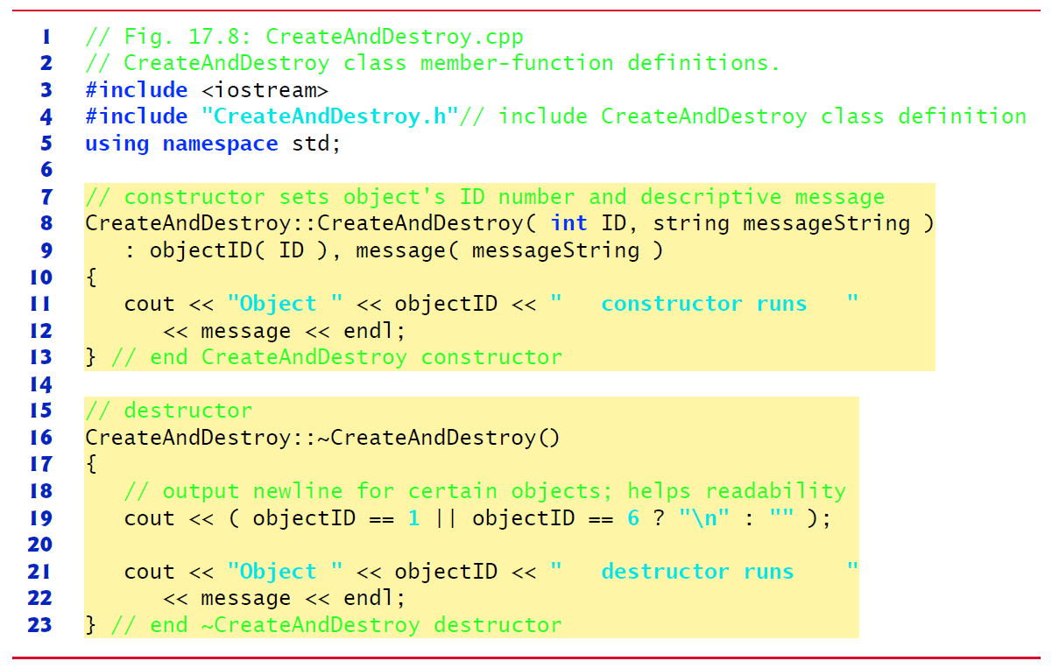
Figure 17.8 CreateAndDestroy Class Member-Function Definitions

Slide 67
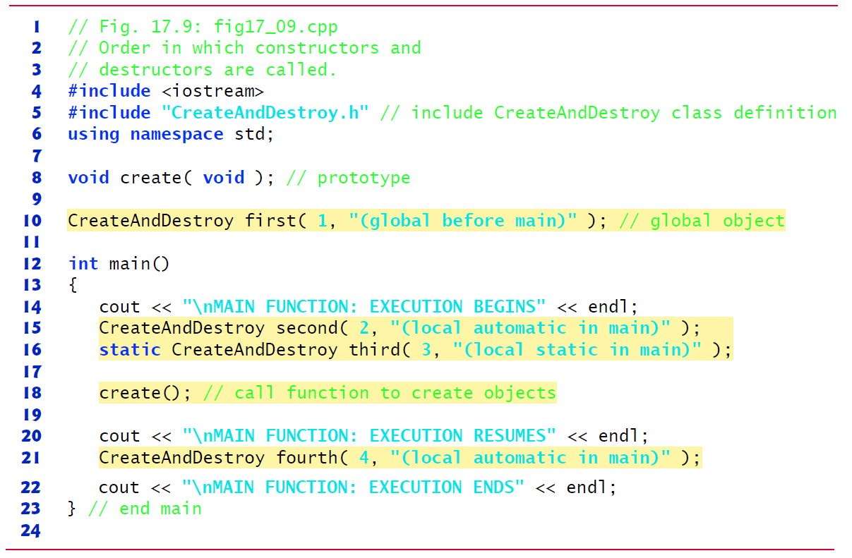
Figure 17.9 Order in Which Constructors and Destructors Are Called (1 of 3)

Slide 68
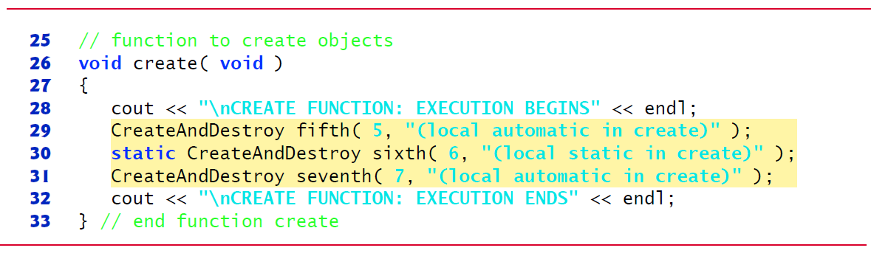
Figure 17.9 Order in Which Constructors and Destructors Are Called (2 of 3)

Slide 69
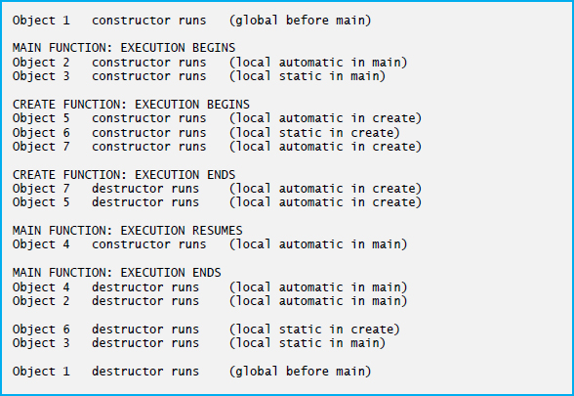
Figure 17.9 Order in Which Constructors and Destructors Are Called (3 of 3)

Slide 70
17.8 Time Class Case Study: A Subtle Trap—Returning a Reference or a Pointer to a Private Data Member (1 of 2)
A reference to an object is an alias for the name of the object and, hence, may be used on the left side of an assignment statement.
In this context, the reference makes a perfectly acceptable lvalue that can receive a value.
Unfortunately a public member function of a class can return a reference to a private data member of that class.
Such a reference return actually makes a call to that member function an alias for the private data member!
The function call can be used in any way that the private data member can be used, including as an lvalue in an assignment statement
The same problem would occur if a pointer to the private data were to be returned by the function.

Slide 71
17.8 Time Class Case Study: A Subtle Trap—Returning a Reference or a Pointer to a Private Data Member (2 of 2)
If a function returns a reference that’s declared const, the reference is a non-modifiable lvalue and cannot be used to modify the data.
The program of Figures. 17.10 (see slide 72)–17.12 (see slides 76-77) uses a simplified Time class (Figure 17.10 and Figure 17.11(see slides 73-74) to demonstrate returning a reference to a private data member with member function badSetHour.

Slide 72
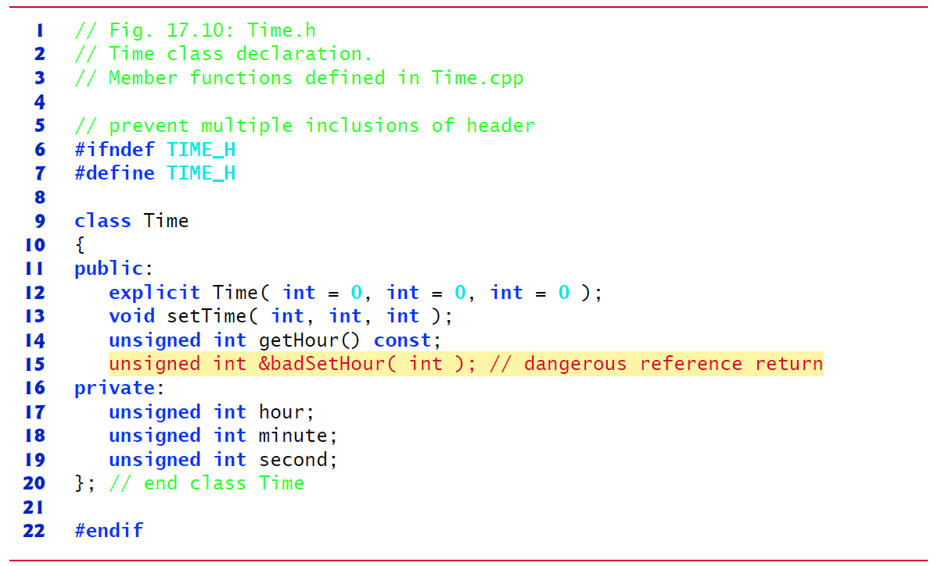
Figure 17.10 Time Class Declaration

Slide 73
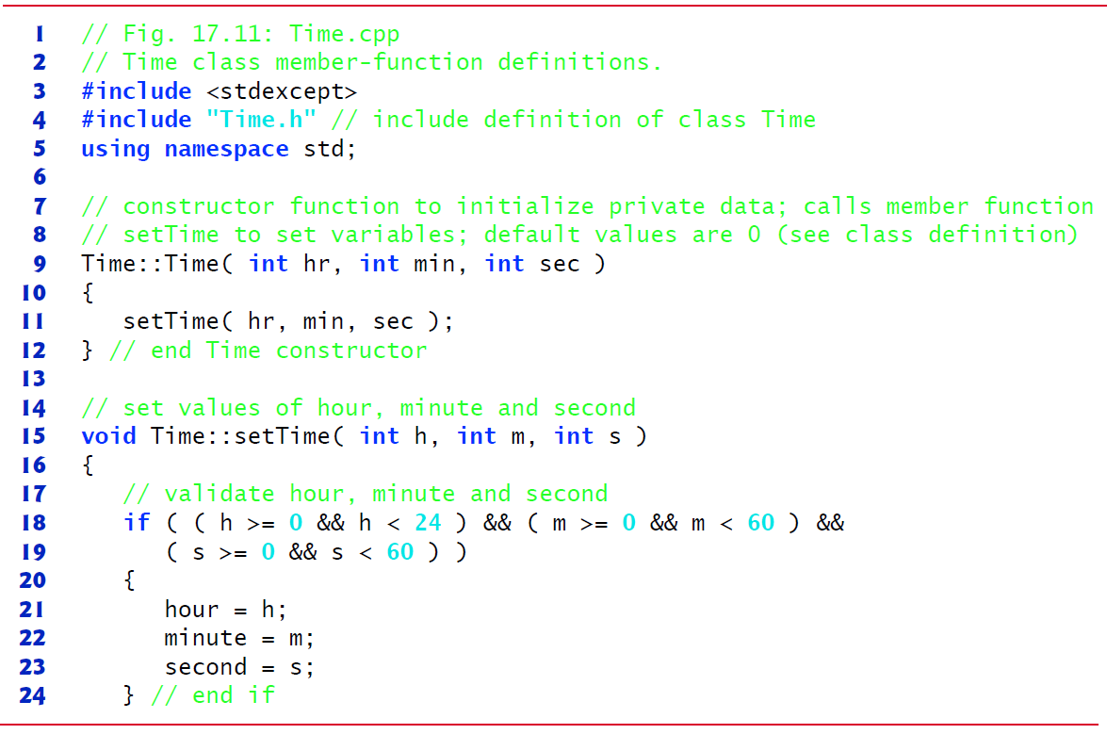
Figure 17.11 Time Class Member-Function Definitions (1 of 2)

Slide 74
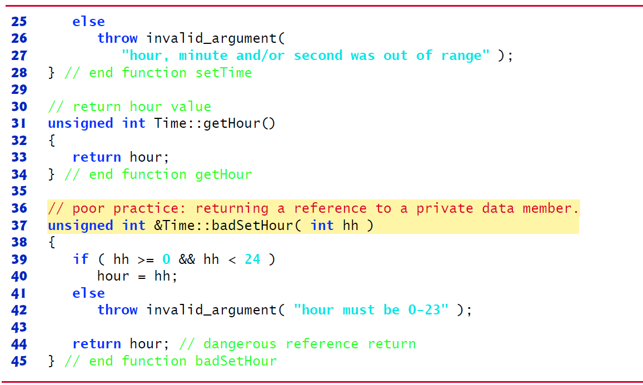
Figure 17.11 Time Class Member-Function Definitions (2 of 2)

Slide 75
Software Engineering Observation 17.7
Returning a reference or a pointer to a private data member breaks the encapsulation of the class and makes the client code dependent on the representation of the class’s data. There are cases where doing this is appropriate—we’ll show an example of this when we build our custom Array class in Section 10.10.

Slide 76
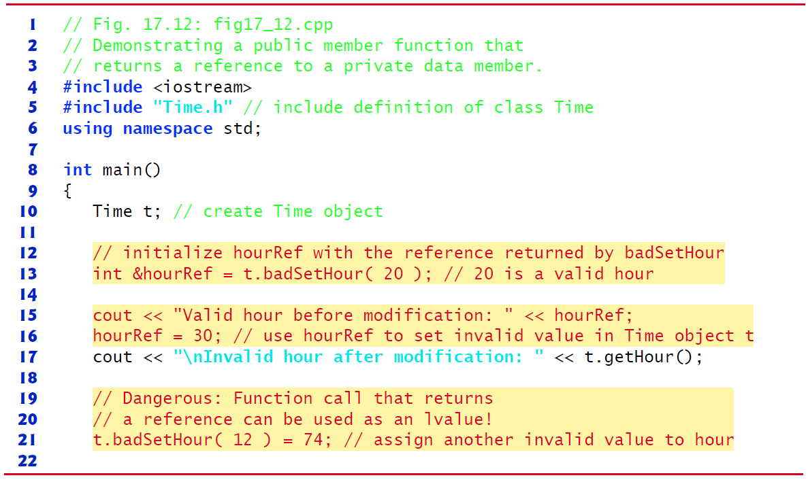
Figure 17.12 Public Member Function That Returns a Reference to a Private Data Member (1 of 2)

Slide 77
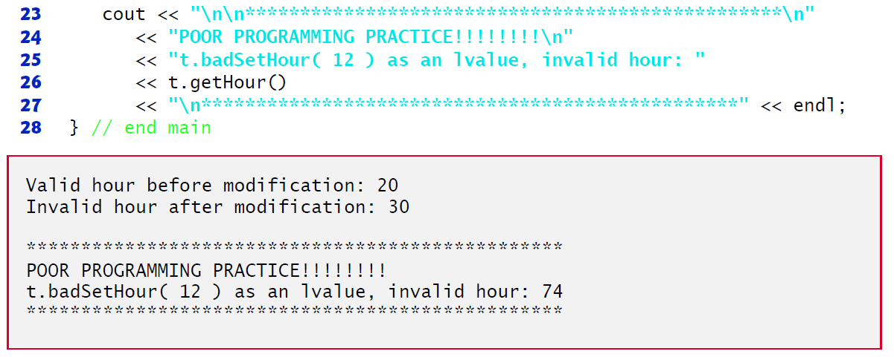
Figure 17.12 Public Member Function That Returns a Reference to a Private Data Member (2 of 2)

Slide 78
17.9 Default Memberwise Assignment (1 of 2)
The assignment operator (=) can be used to assign an object to another object of the same type.
By default, such assignment is performed by memberwise assignment (also called copy assignment).
Each data member of the object on the right of the assignment operator is assigned individually to the same data member in the object on the left of the assignment operator.
[Caution: Memberwise assignment can cause serious problems when used with a class whose data members contain pointers to dynamically allocated memory; we discuss these problems in Chapter 10 and show how to deal with them.]

Slide 79
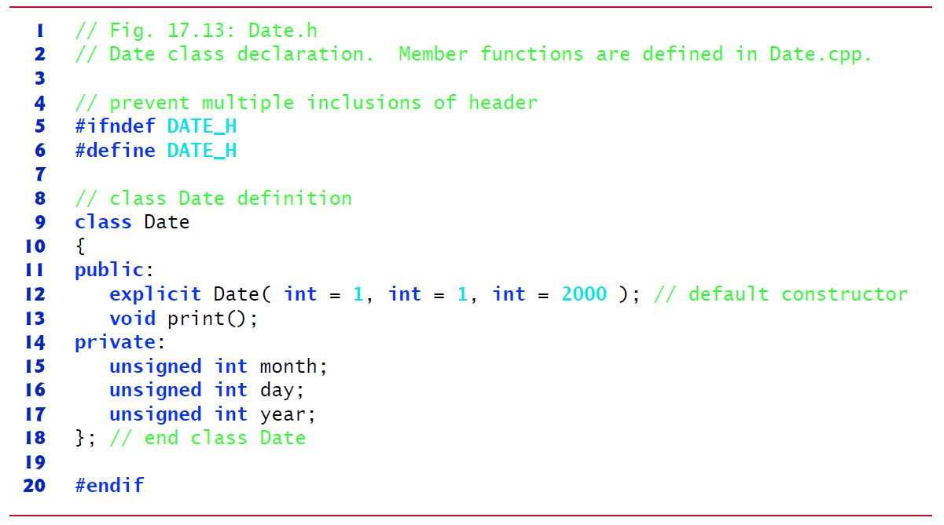
Figure 17.13 Date Class Declaration

Slide 80
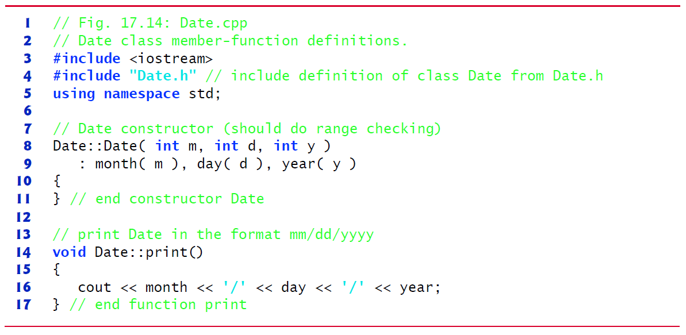
Figure 17.14 Date Class Member-Function Definitions

Slide 81
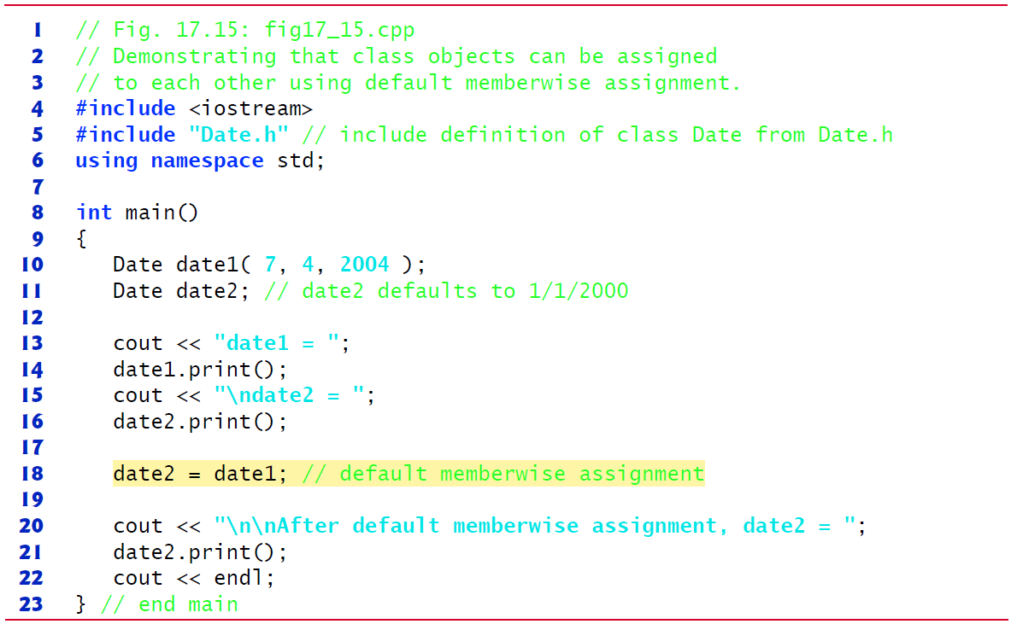
Figure 17.15 Class Objects Can Be Assigned to Each Other Using Default Memberwise Assignment (1 of 2)

Slide 82
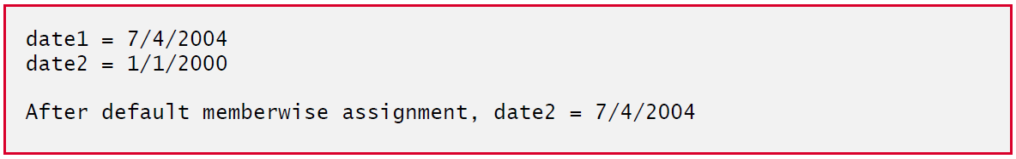
Figure 17.15 Class Objects Can Be Assigned to Each Other Using Default Memberwise Assignment (2 of 2)

Slide 83
17.9 Default Memberwise Assignment (2 of 2)
Objects may be passed as function arguments and may be returned from functions.
Such passing and returning is performed using pass-by-value by default—a copy of the object is passed or returned.
C++ creates a new object and uses a copy constructor to copy the original object’s values into the new object.
For each class, the compiler provides a default copy constructor that copies each member of the original object into the corresponding member of the new object.
Copy constructors can cause serious problems when used with a class whose data members contain pointers to dynamically allocated memory.
Chapter 10 discusses customized copy constructors.

Slide 84
17.10 Const Objects and Const Member Functions (1 of 4)
Some objects need to be modifiable and some do not.
You may use keyword const to specify that an object is not modifiable and that any attempt to modify the object should result in a compilation error.
The statement
declares a const object noon of class Time and initializes it to 12 noon. It’s possible to instantiate const and non- const objects of the same class.

Slide 85
Software Engineering Observation 17.8
Attempts to modify a const object are caught at compile time rather than causing execution-time errors.

Slide 86
Performance Tip 17.3
Declaring variables and objects const when appropriate can improve performance— compilers can perform optimizations on constants that cannot be performed on non-const variables.

Slide 87
17.10 Const Objects and Const Member Functions
C++ disallows member function calls for const objects unless the member functions themselves are also declared const.
This is true even for get member functions that do not modify the object.
This is also a key reason that we’ve declared as const all member-functions that do not modify the objects on which they’re called.
A member function is specified as const both in its prototype by inserting the keyword const after the function’s parameter list and, in the case of the function definition, before the left brace that begins the function body.

Slide 88
Common Programming Error 17.2
Defining as const a member function that modifies a data member of the object is a compilation error.

Slide 89
Common Programming Error 17.3
Defining as const a member function that calls a non-const member function of the class on the same object is a compilation error.

Slide 90
Common Programming Error 17.4
Invoking a non-const member function on a const object is a compilation error.

Slide 91
17.10 Const Objects and Const Member Functions (3 of 4)
A constructor must be allowed to modify an object so that the object can be initialized properly.
A destructor must be able to perform its termination housekeeping chores before an object’s memory is reclaimed by the system.
Attempting to declare a constructor or destructor const is a compilation error.
The “constness” of a const object is enforced from the time the constructor completes initialization of the object until that object’s destructor is called.

Slide 92
17.10 Const Objects and Const Member Functions (4 of 4)
Using const and Non-const Member Functions
The program of Figure 17.16 uses class Time from Figures 17.4 (see slides 41-42)–17.5 (see slides 44-47), but removes const from function printStandard’s prototype and definition so that we can show a compilation error.

Slide 93
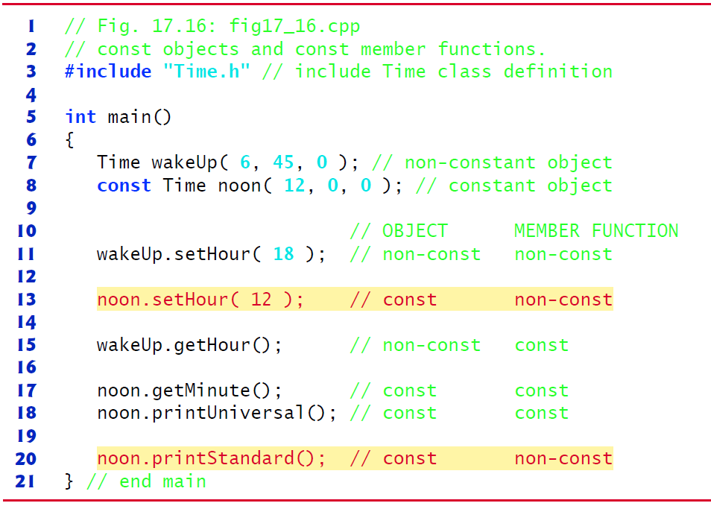
Figure 17.16 Const Objects and Const Member Functions (1 of 2)

Slide 94
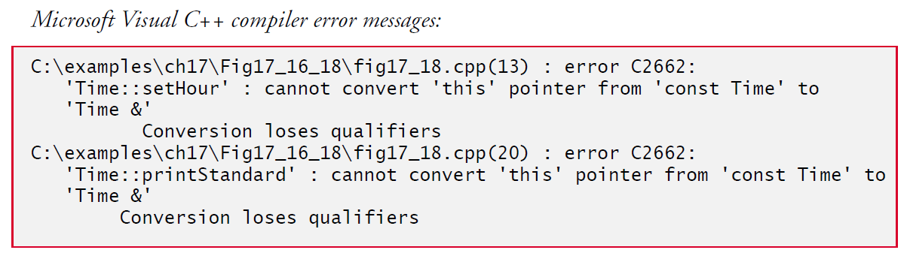
Figure 17.16 Const Objects and Const Member Functions (2 of 2)

Slide 95
17.11 Composition: Objects as Members of Classes (1 of 6)
An AlarmClock object needs to know when it’s supposed to sound its alarm, so why not include a Time object as a member of the AlarmClock class?
Such a capability is called composition and is sometimes referred to as a has-a relationship—a class can have objects of other classes as members.
The next program uses classes Date (Figures 17.17 (see slide 98)–17.18 (see slide 99)) and Employee (Figures 17.19 (see slide 102)–17.20 (see slide 103)) to demonstrate composition.

Slide 96
Software Engineering Observation 17.9
A common form of software reusability is composition, in which a class has objects of other types as members.

Slide 97
Software Engineering Observation 17.10
Data members are constructed in the order in which they’re declared in the class definition (not in the order they’re listed in the constructor’s member initializer list) and before their enclosing class objects (sometimes called host objects) are constructed

Slide 98
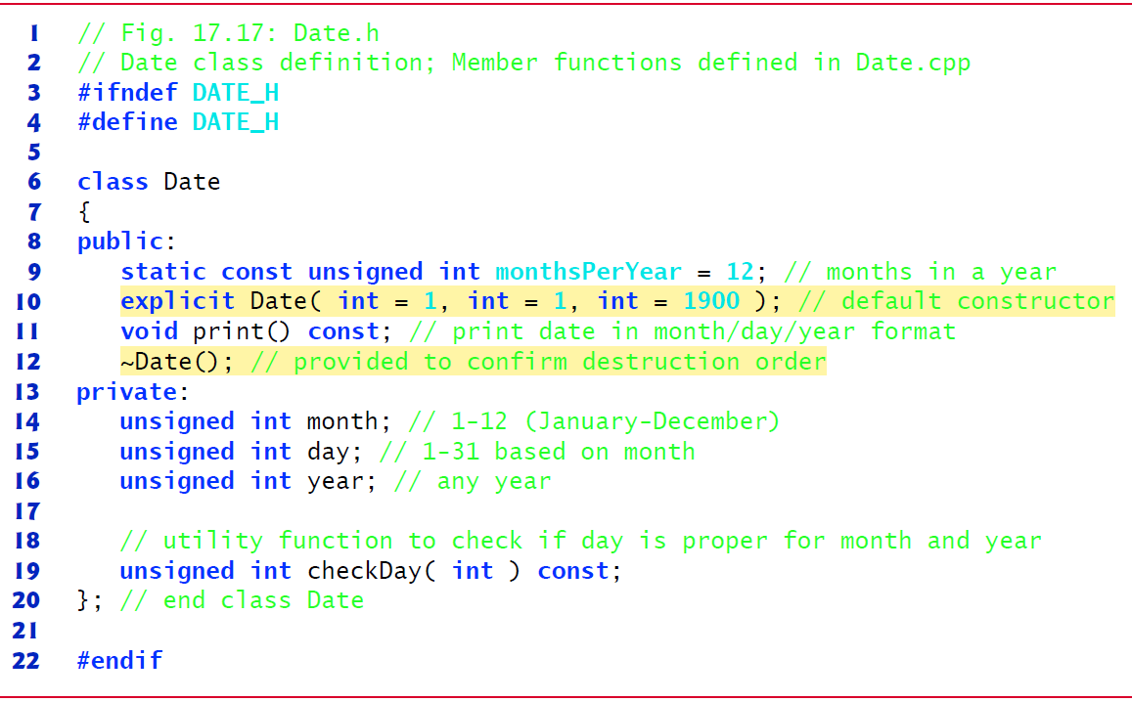
Figure 17.17 Date Class Definition

Slide 99
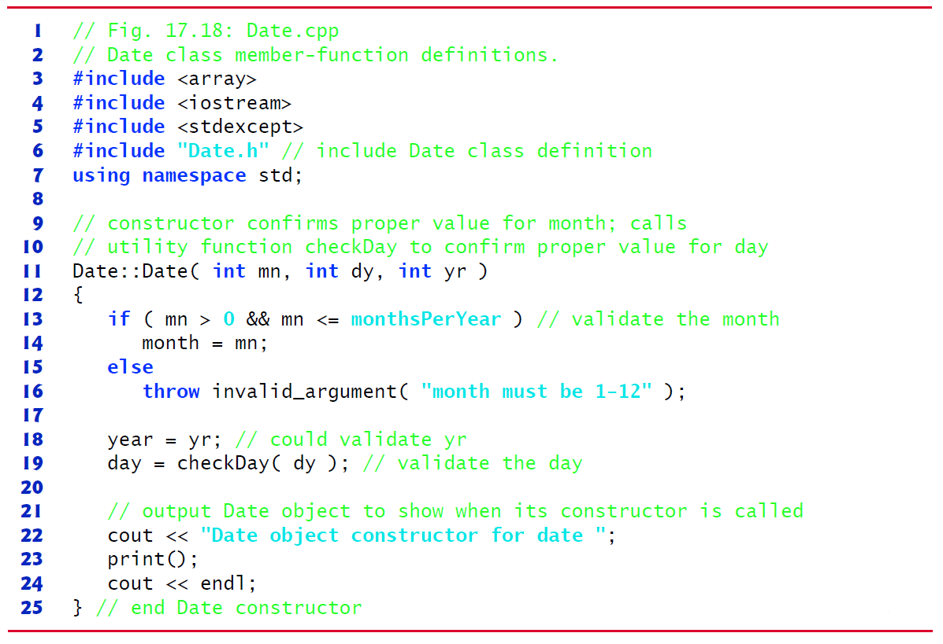
Figure 17.18 Date Class Member-Function Definitions (1 of 3)

Slide 100
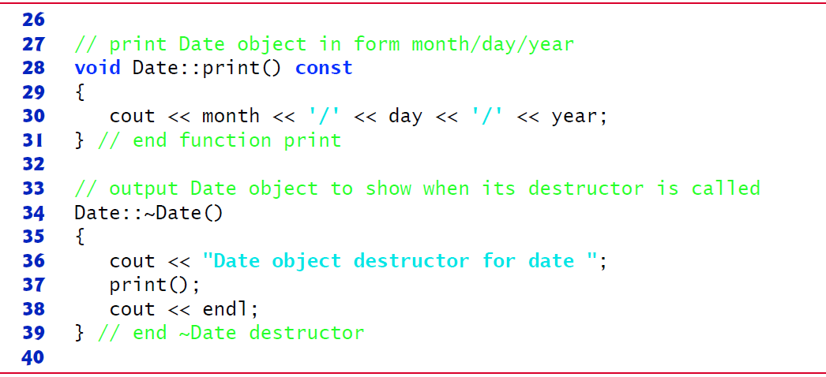
Figure 17.18 Date Class Member-Function Definitions (2 of 3)

Slide 101
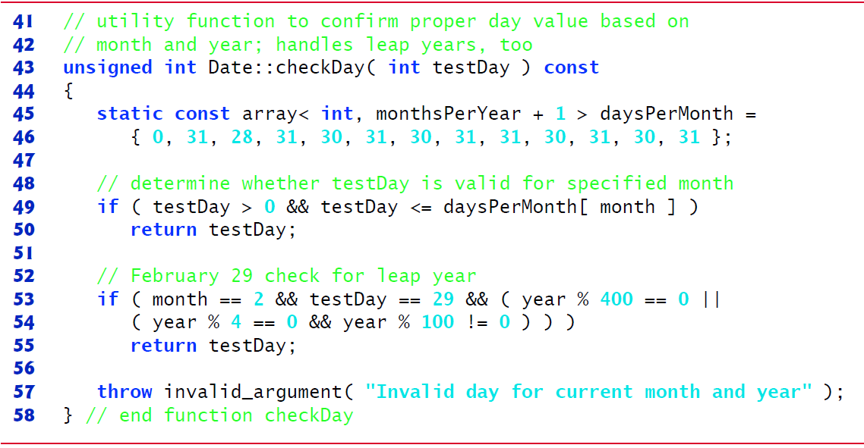
Figure 17.18 Date Class Member-Function Definitions (3 of 3)

Slide 102
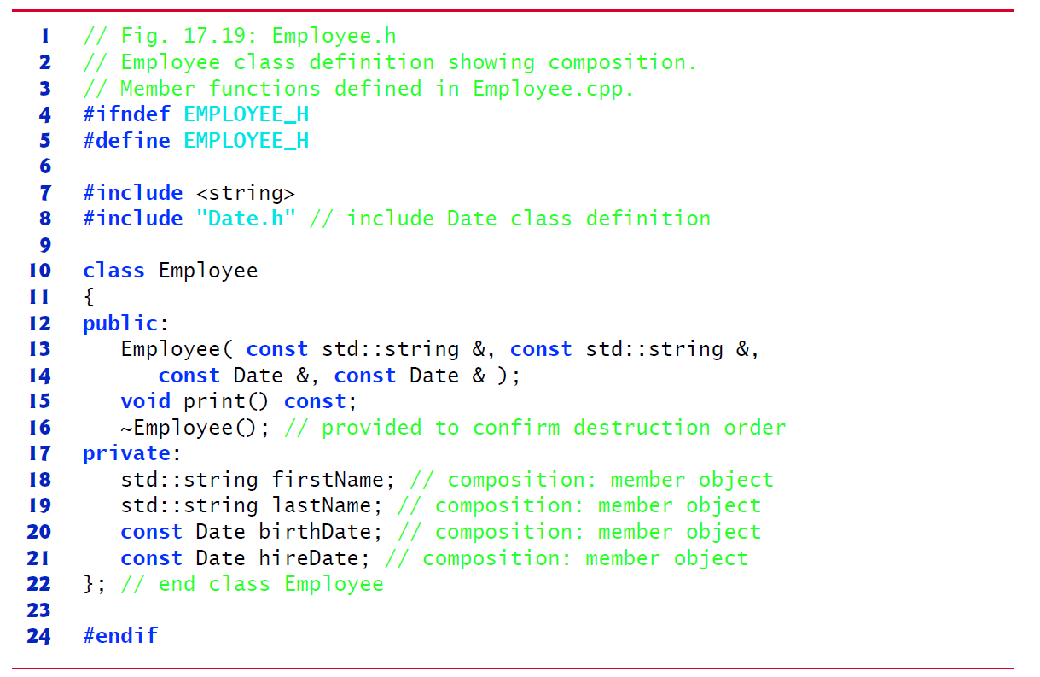
Figure 17.19 Employee Class Definition Showing Composition

Slide 103
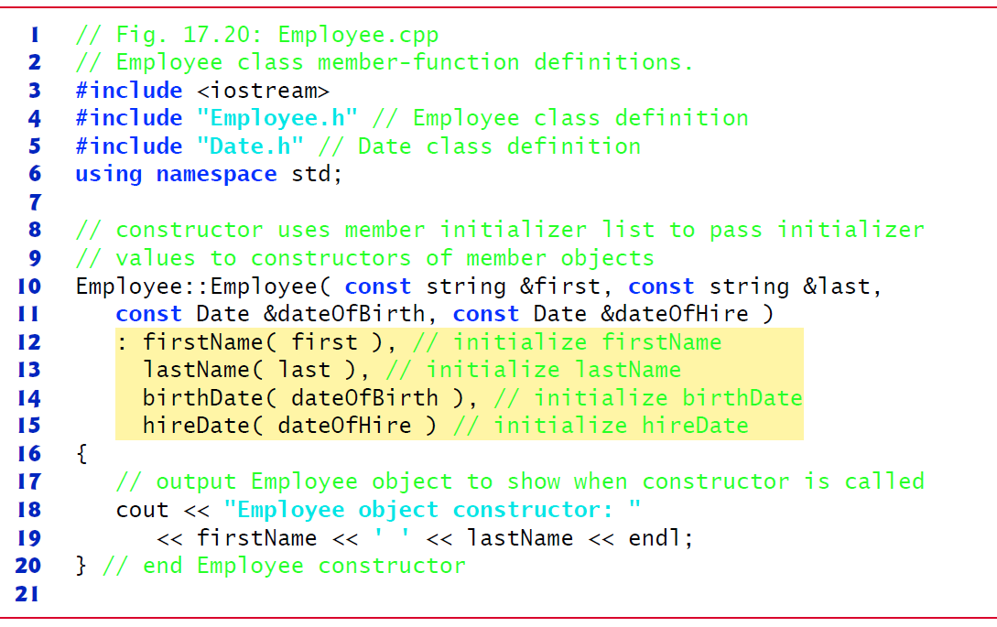
Figure 17.20 Employee Class Member-Function Definitions (1 of 2)

Slide 104
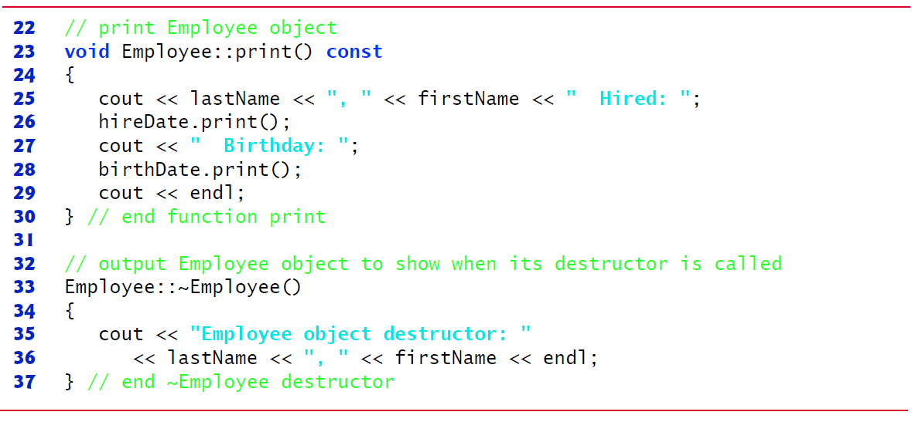
Figure 17.20 Employee Class Member-Function Definitions (2 of 2)

Slide 105
17.11 Composition: Objects as Members of Classes (2 of 6)
Employee Constructor’s Member Initializer List
The colon (:) following the constructor’s header (Figure 17.20 (see slide 103), line 12) (begins the member initializer list.
The member initializers specify the Employee constructor parameters being passed to the constructors of the string and Date data members.
Again, member initializers are separated by commas.
The order of the member initializers does not matter.
They’re executed in the order that the member objects are declared in class Employee.

Slide 106
Good Programming Practice 17.3
For clarity, list member initializers in the order that the class’s data members are declared.

Slide 107
17.11 Composition: Objects as Members of Classes (3 of 6)
Date Class’s Default Copy Constructor
As we mentioned in Section 17.9, the compiler provides each class with a default copy constructor that copies each data member of the constructor’s argument object into the corresponding member of the object being initialized.
Chapter 10 discusses how you can define customized copy constructors.

Slide 108
17.11 Composition: Objects as Members of Classes (4 of 6)
Testing Classes Date and Employee
Figure 17.21 (see slide 110-111) creates two Date objects (lines 10–11) and passes them as arguments to the constructor of the Employee object created in line 12.
Line 15 outputs the Employee object’s data.
When each Date object is created in lines 10–11, the Date constructor defined in lines 11–25 of Figure 17.18 (see slide 99-101) displays a line of output to show that the constructor was called (see the first two lines of the sample output).

Slide 109
17.11 Composition: Objects as Members of Classes (5 of 6)
[Note: Line 12 of Figure 17.21 (slide 110-111) causes two additional Date constructor calls that do not appear in the program’s output. When each of the Employee’s Date member objects is initialized in the Employee constructor’s member-initializer list (Figure 17.20, (see slide 103) lines 14–15), the default copy constructor for class Date is called. Since this constructor is defined implicitly by the compiler, it does not contain any output statements to demonstrate when it’s called.]

Slide 110
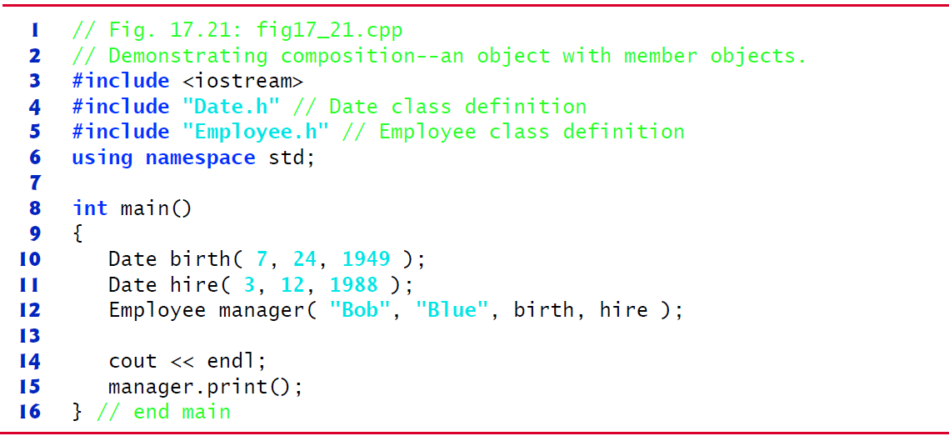
Figure 17.21 Demonstrating Composition—an Object with Member Objects (1 of 2)

Slide 111
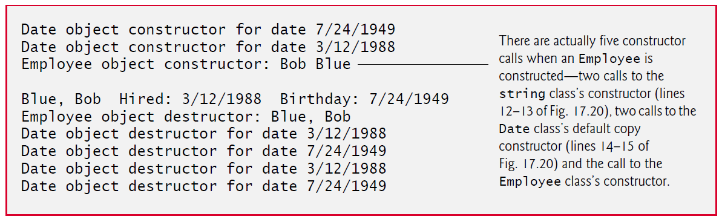
Figure 17.21 Demonstrating Composition—an Object with Member Objects (2 of 2)

Slide 112
17.11 Composition: Objects as Members of Classes (6 of 6)
What Happens When You Do Not Use the Member Initializer List?
If a member object is not initialized through a member initializer, the member object’s default constructor will be called implicitly.
Values, if any, established by the default constructor can be overridden by set functions.
However, for complex initialization, this approach may require significant additional work and time.

Slide 113
Common Programming Error 17.5
A compilation error occurs if a member object is not initialized with a member initializer and the member object’s class does not provide a default constructor (i.e., the member object’s class defines one or more constructors, but none is a default constructor).

Slide 114
Performance Tip 17.4
Initialize member objects explicitly through member initializers. This eliminates the overhead of “doubly initializing” member objects—once when the member object’s default constructor is called and again when set functions are called in the constructor body (or later) to initialize the member object.

Slide 115
Software Engineering Observation 17.11
If a data member is an object of another class, making that member object public does not violate the encapsulation and hiding of that member object’s private members. But, it does violate the encapsulation and hiding of the containing class’s implementation, so member objects of class types should still be private.

Slide 116
17.12 Friend Functions and Friend Classes (1 of 5)
A friend function of a class is a non-member function that has the right to access the public and non-public class members.
Standalone functions, entire classes or member functions of other classes may be declared to be friends of another class.

Slide 117
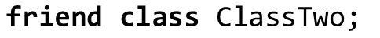
17.12 Friend Functions and Friend Classes (2 of 5)
Declaring a friend
To declare a function as a friend of a class, precede the function prototype in the class definition with keyword friend.
To declare all member functions of class ClassTwo as friends of class ClassOne, place a declaration of the form
in the definition of class ClassOne.
Friendship is granted, not taken—for class B to be a friend of class A, class A must explicitly declare that class B is its friend.
Friendship is not symmetric—if class A is a friend of class B, you cannot infer that class B is a friend of class A.
Friendship is not transitive—if class A is a friend of class B and class B is a friend of class C, you cannot infer that class A is a friend of class C.

Slide 118
17.12 Friend Functions and Friend Classes (3 of 5)
Modifying a Class’s private Data with a Friend Function
Figure 17.22 is a mechanical example in which we define friend function setX to set the private data member x of class Count.
We place the friend declaration first in the class definition, even before public member functions are declared.
Function setX is a stand-alone (global) function—it isn’t a member function of class Count.
For this reason, when setX is invoked for object counter, line 41 passes counter as an argument to setX rather than using a handle (such as the name of the object) to call the function, as in
If you remove the friend declaration in line 9, you’ll receive error messages indicating that function setX cannot modify class Count’s private data member x.

Slide 119
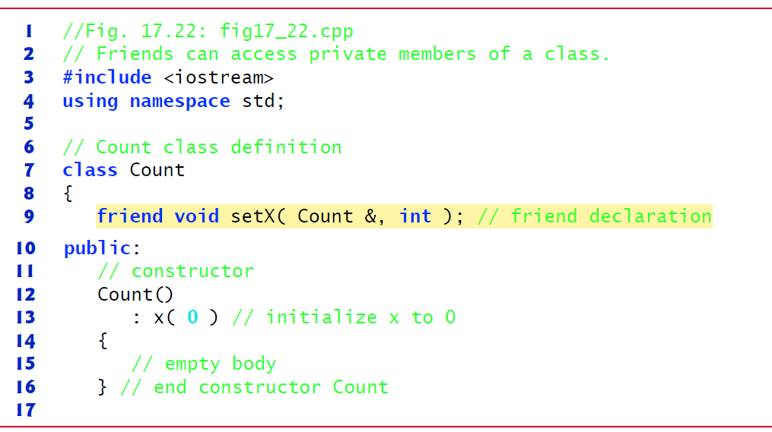
Figure 17.22 Friends Can Access Private Members of a Class (1 of 3)

Slide 120
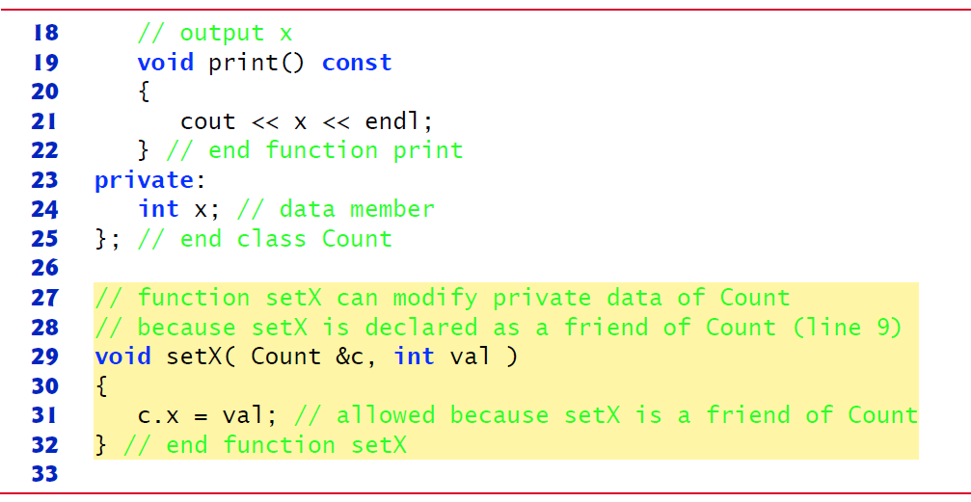
Figure 17.22 Friends Can Access Private Members of a Class (2 of 3)

Slide 121
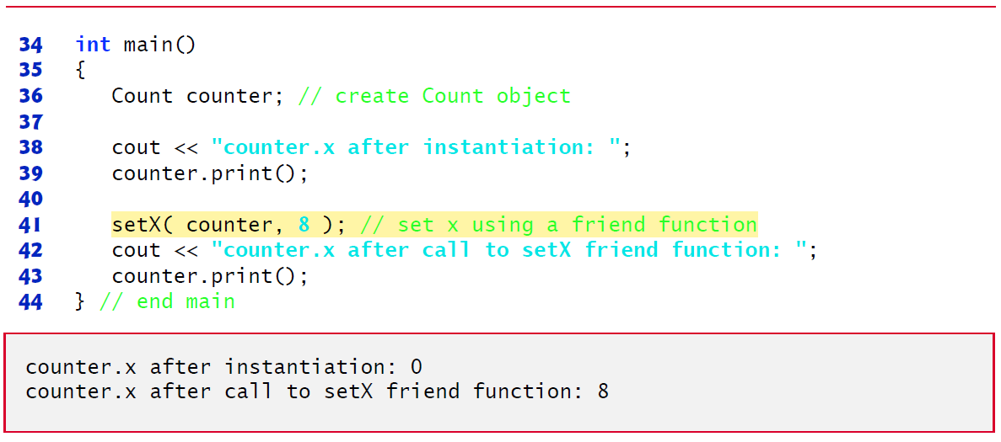
Figure 17.22 Friends Can Access Private Members of a Class (3 of 3)

Slide 122
17.12 Friend Functions and Friend Classes (4 of 5)
It would normally be appropriate to define function setX as a member function of class Count.
It would also normally be appropriate to separate the program of Figure 17.22 into three files:
A header (e.g., Count.h) containing the Count class definition, which in turn contains the prototype of friend function setX
An implementation file (e.g., Count.cpp) containing the definitions of class Count’s member functions and the definition of friend function setX
A test program (e.g., figure17_22.cpp) with main.

Slide 123
17.12 Friend Functions and Friend Classes (5 of 5)
Overloaded friend Functions
It’s possible to specify overloaded functions as friends of a class.
Each function intended to be a friend must be explicitly declared in the class definition as a friend of the class.

Slide 124
Software Engineering Observation 17.12
Even though the prototypes for friend functions appear in the class definition, friends are not member functions.

Slide 125
Software Engineering Observation 17.13
Member access notions of private, protected and public are not relevant to friend declarations, so friend declarations can be placed anywhere in a class definition.

Slide 126
Good Programming Practice 17.4
Place all friendship declarations first inside the class definition’s body and do not precede them with any access specifier.

Slide 127
17.13 Using the this Pointer (1 of 6)
Every object has access to its own address through a pointer called this (a C++ keyword).
The this pointer is not part of the object itself—i.e., the memory occupied by the this pointer is not reflected in the result of a sizeof operation on the object.
Rather, the this pointer is passed (by the compiler) as an implicit argument to each of the object’s non-static member functions.

Slide 128
17.13 Using the this Pointer (2 of 6)
Using the this Pointer to Avoid Naming Collisions
Member functions use the this pointer implicitly (as we’ve done so far) or explicitly to reference an object’s data members and other member functions.
A common explicit use of the this pointer is to avoid naming conflicts between a class’s data members and member-function parameters (or other local variables).

Slide 129
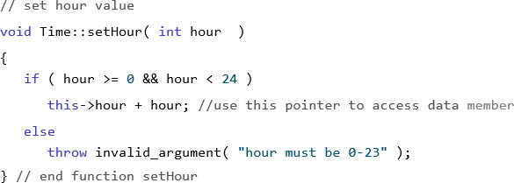
17.13 Using the this Pointer (3 of 6)
Consider the Time class’s hour data member and setHour member function in Figures. 17.4 (see slides 41-42)–17.5 (see slide 44-47).
We could have defined setHour as:

Slide 130
Error-Prevention Tip 17.4
To make your code clearer and more maintainable, and to avoid errors, never hide data members with local variable names.

Slide 131
17.13 Using the this Pointer (4 of 6)
Type of the this Pointer
The type of the this pointer depends on the type of the object and whether the member function in which this is used is declared const.
For example, in a non-const member function of class Employee, the this pointer has the type Employee *. In a const member function, the this pointer has the type const Employee *.

Slide 132
17.13 Using the this Pointer (5 of 6)
Implicitly and Explicitly Using the this Pointer to Access an Object’s Data Members
Figure 17.23 demonstrates the implicit and explicit use of the this pointer to enable a member function of class Test to print the private data x of a Test object.
In the next example and in Chapter 10, we show some substantial and subtle examples of using this.

Slide 133

Figure 17.23 Using the this Pointer to Refer to Object Members (1 of 3)

Slide 134

Figure 17.23 Using the this Pointer to Refer to Object Members (2 of 3)

Slide 135

Figure 17.23 Using the this Pointer to Refer to Object Members (3 of 3)

Slide 136
17.13 Using the this Pointer (6 of 6)
Using the this Pointer to Enable Cascaded Function Calls
Another use of the this pointer is to enable cascaded member-function calls—that is, invoking multiple functions in the same statement (as in line 12 of Figure 17.26 (see slides 144-145)).
The program of Figures. 17.24 (see slides 137-138)–17.26 (see slides 144-145) modifies class Time’s set functions setTime, setHour, setMinute and setSecond such that each returns a reference to a Time object to enable cascaded member-function calls.
Notice in Figure 17.25 (see slides 139-143) that the last statement in the body of each of these member functions returns *this (lines 23, 34, 45 and 56) into a return type of Time &.
The program of Figure 17.26 (see slides 144-145) creates Time object t (line 9), then uses it in cascaded member-function calls (lines 12 and 24).

Slide 137

Figure 17.24 Time Class Modified to Enable Cascaded Member-Function Calls (1 of 2)

Slide 138

Figure 17.24 Time Class Modified to Enable Cascaded Member-Function Calls (2 of 2)

Slide 139

Figure 17.25 Time Class Member-Function Definitions Modified to Enable Cascaded Memberfunction Calls (1 of 5)

Slide 140

Figure 17.25 Time Class Member-Function Definitions Modified to Enable Cascaded Memberfunction Calls (2 of 5)

Slide 141

Figure 17.25 Time Class Member-Function Definitions Modified to Enable Cascaded Memberfunction Calls (3 of 5)

Slide 142

Figure 17.25 Time Class Member-Function Definitions Modified to Enable Cascaded Memberfunction Calls (4 of 5)

Slide 143

Figure 17.25 Time Class Member-Function Definitions Modified to Enable Cascaded Memberfunction Calls (5 of 5)

Slide 144

Figure 17.26 Cascading Member-Function Calls with the this Pointer (1 of 2)

Slide 145

Figure 17.26 Cascading Member-Function Calls with the this Pointer (2 of 2)

Slide 146
17.14 Static Class Members (1 of 4)
In certain cases, only one copy of a variable should be shared by all objects of a class.
A static data member is used for these and other reasons.
Such a variable represents “class-wide” information, i.e., data that is shared by all instances and is not specific to any one object of the class.

Slide 147
Performance Tip 17.5
Use static data members to save storage when a single copy of the data for all objects of a class will suffice.

Slide 148
17.14 Static Class Members (2 of 4)
Scope and Initialization of static Data Members
static data members have class scope.
A static data member must be initialized exactly once.
Fundamental-type static data members are initialized by default to 0.
Prior to C++11, a static const data member of int or enum type could be initialized in its declaration in the class definition and all other static data members had to be defined and initialized at global namespace scope (i.e., outside the body of the class definition).
Again, C++11’s in-class initializers also allow you to initialize these variables where they’re declared in the class definition.

Slide 149
17.14 Static Class Members (3 of 4)
Accessing static Data Members
A class’s private and protected static members are normally accessed through the class’s public member functions or friends.
A class’s static members exist even when no objects of that class exist.
To access a public static class member when no objects of the class exist, simply prefix the class name and the scope resolution operator
to the name of the data member.
To access a private or protected static class member when no objects of the class exist, provide a public static member function and call the function by prefixing its name with the class name and scope resolution operator.
A static member function is a service of the class, not of a specific object of the class.

Slide 150
Software Engineering Observation 17.14
A class’s static data members and static member functions exist and can be used even if no objects of that class have been instantiated.

Slide 151
17.14 Static Class Members (4 of 4)
Demonstrating static Data Members
The program of Figures 17.27 (see slide 152-153)–17.29 (see slide 156-158) demonstrates a private static data member called count (Figure 17.27, line 24) and a public static member function called getCount (Figure 17.27, line 18).

Slide 152

Figure 17.27 Employee Class Definition with a Static Data Member to Track the Number of Employee Objects in Memory (1 of 2)

Slide 153

Figure 17.27 Employee Class Definition with a Static Data Member to Track the Number of Employee Objects in Memory (2 of 2)

Slide 154

Figure 17.28 Employee Class Member-Function Definitions (1 of 2)

Slide 155

Figure 17.28 Employee Class Member-Function Definitions (2 of 2)

Slide 156

Figure 17.29 Static Data Member Tracking the Number of Objects of a Class (1 of 3)

Slide 157

Figure 17.29 Static Data Member Tracking the Number of Objects of a Class (2 of 3)

Slide 158

Figure 17.29 Static Data Member Tracking the Number of Objects of a Class (3 of 3)

Slide 159
Common Programming Error 17.6
Using the this pointer in a static member function is a compilation error.

Slide 160
Common Programming Error 17.7
Declaring a static member function const is a compilation error. The const qualifier indicates that a function cannot modify the contents of the object on which it operates, but static member functions exist and operate independently of any objects of the class.

Slide 161

Copyright

